Slide 1
How to Create Solutions for Relativity & ADS Solutions

Slide 2
Chandra Alimeti
Michael Masanek

Slide 3
Visual Studio project templates
NuGet packages
Working in one application
Publish to Relativity

Slide 4
Starting Development

Slide 5
Visual Studio project templates + NuGet Packages
Creating a Relativity Application
Develop a Relativity Event Handler
Publish to Relativity
Section Overview

Slide 6
Pre-created class files
Overridable functions
Auto-filled class attributes
GUID
Execution type
Version specific
Generally work across versions
Visual Studio Marketplace
Visual Studio project templates

Slide 7
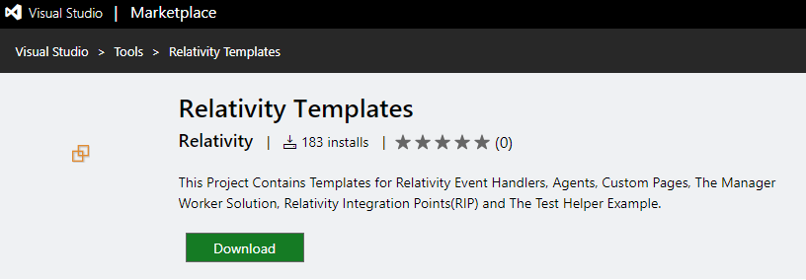
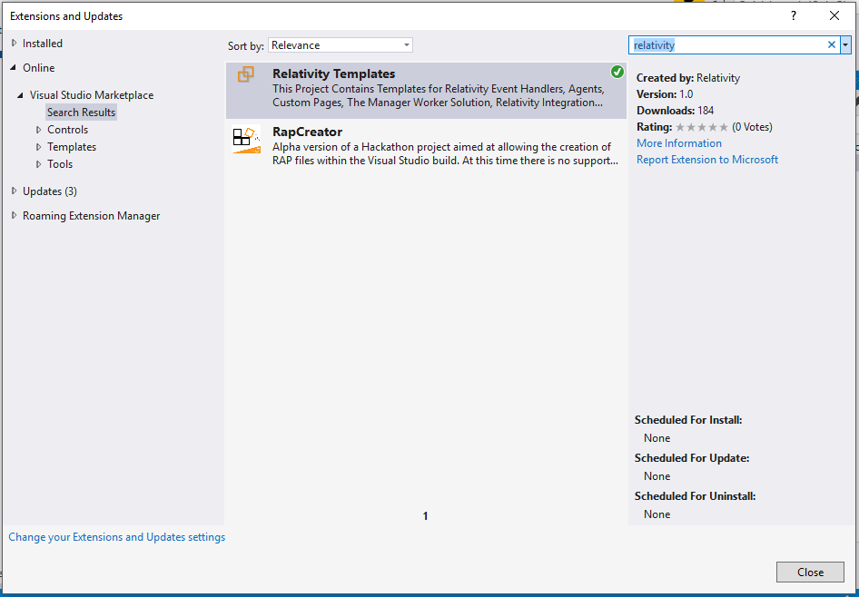
Visual Studio project templates

Slide 8
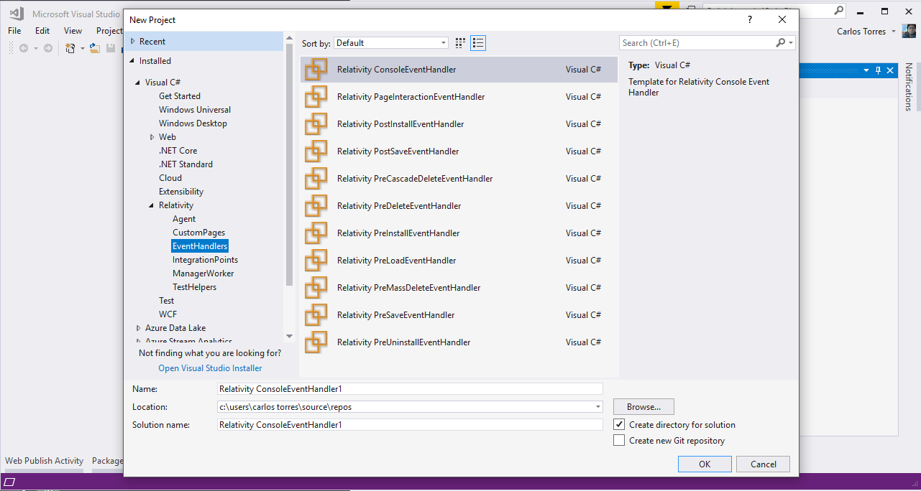
Visual Studio project templates

Slide 9
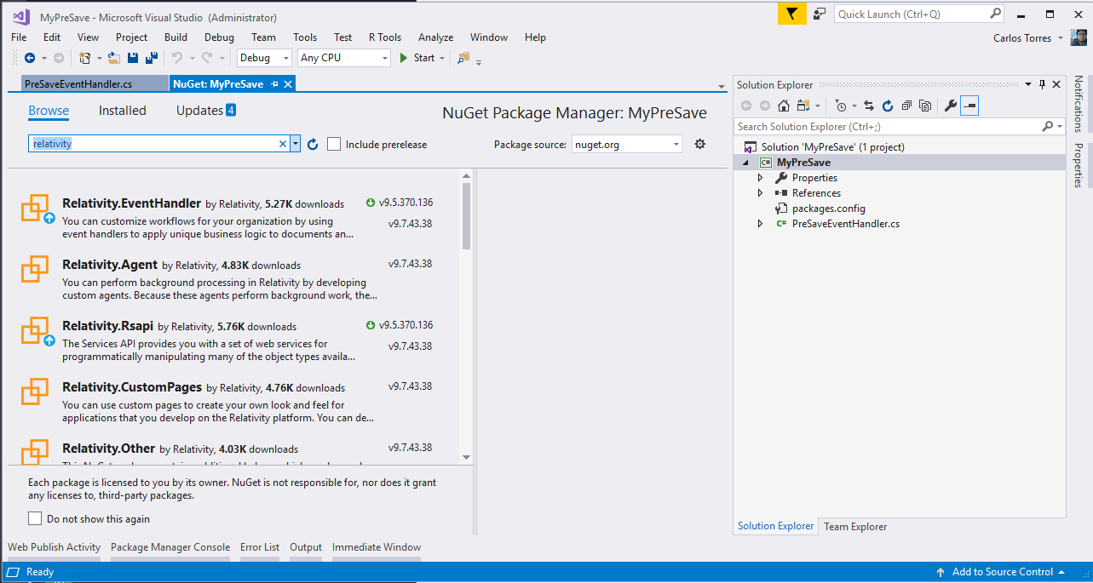
NuGet packages

Slide 10
Extend Relativity
Customized workflows
Custom Objects (RDOs)
Extensibility Points
Event Handlers
Agents
Custom Pages
Exportable to other workspaces/instances
Relativity Applications
Overview

Slide 11
Event handlers
Pre/post save
Pre/post install
Page interaction
Agents
Background processes
Custom page
Customize UI
Extensibility Points Overview

Slide 12
Quick upload of application files
Resource files
Custom pages
Set your configuration and publish with a Click!
Publish to Relativity

Slide 13
Starting Development
Section 3 Page 11

Slide 14
Create a Relativity Application
"Build your first application"
Develop a Relativity Event Handler
"Build your first event handler"
Visual Studio Templates
"Visual Studio templates"
Publish to Relativity
"Publish to Relativity tool"
Documentation
References

